Slide 1

Sentiment Analysis of Twitter Data
FR
FABRIKAM RESIDENCES
CIS 5367 Machine Learning
Group Members:
David Kurtenbach
Ayodamloa Olanipekun
Seth Paniagua
Cuong Phan
Folusayo Togun

Slide 2

Project Description
Sentiment Analysis of Twitter Data
Develop and implement a machine learning sentiment analysis model
Analyze Twitter data of large fashion brands
Train/test model
Inform marketing efforts in the fashion industry

Slide 3

Business Case
Targeted Marketing
Local fashion startup company of >75 employees
Sell fast fashion and looking to improve targeted marketing for upcoming quarter
Analysis of 8 large fashion company Twitter feeds to identify trends and inform marketing campaign

Slide 4
Data Description
Sample and Timeframe
Data Details
Fashion Companies
Sample tweets of 8 large fashion companies
Date Range:
2020-01-01 to Present
Sample Size:
Index of 10,000 samples
Data Columns:
Brand Name
Tweet
Polarity
Gucci - #gucci
Polo - #polo
Chanel - #chanel
Burberry - #burberry
Prada - #prada
Versace - #versace
Fendi - #fendi
Hermes - #hermes

Slide 5



Data Source
Accessing Twitter Data
Publicly accessible information
Twitter data imported using an API
Limited to specific twitter handles
Data sourced directly from Excel file

Slide 6
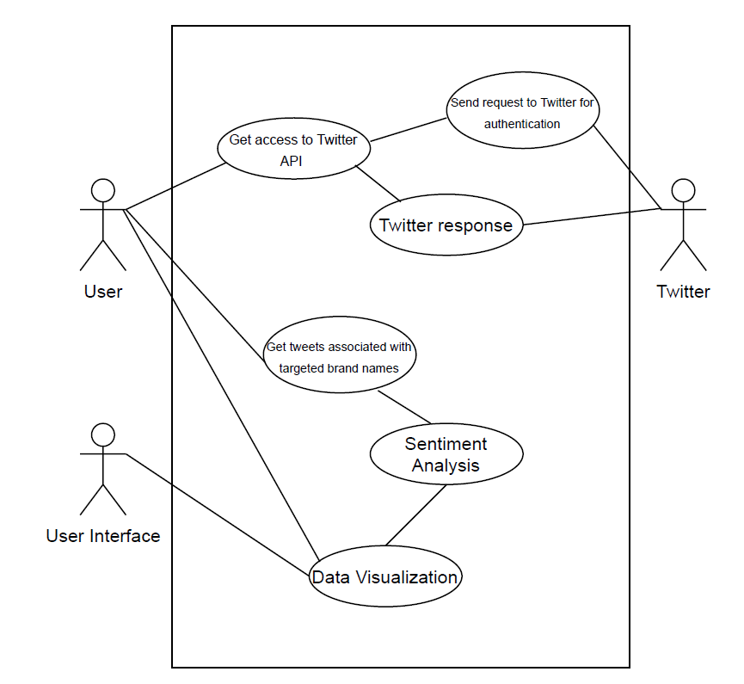
Use Case
User accesses data through Twitter API
Tweets by brand names
Sentiment analysis
Visualize the data

Slide 7
Python Packages
Data Analysis Tools Used
NLTK (Natural Language Tool Kit)
Naïve Bayes Classifier
PySpark – HashingTF, IDF, Tokenizer
Multiclass Classification Evaluator
Assessed Values:
Polarity: Negative vs. Positive (-1.0 => +1.0)
Identifies words and phrases it can identify, assigns values, and calculates overall score

Slide 8

Getting the Data
Accessing the Twitter raw data
Read data into python using API
Create a dataframe of select Twitter feeds
Use TextBlob to generate polarity of tweets
Generate .csv file to be used to build the model

Slide 9

Data Preparation
Cleaning Dataset
Add Polarity Type
> 0 = “Positive”
0 = “Neutral”
< 0 = “Negative”
Split data into Training/Testing 80/20
Training Data = 7,433
Testing Data = 1,836
Index the polarity type

Slide 10

Data Analysis Process
Apply Spark Dataframe to manipulate and discover data
Preprocess Data
Remove duplicated tweets
Tokenize the tweets
Remove numbers
Eliminate unnecessary words such as I,are,is,the,..
Stem text data
Preprocess Data
HashingTF
Term frequency transformer that vectorizes the text
Inverse Document Frequency (IDF)
Estimator that fits to the dataset and scales the hashed vectors

Slide 11

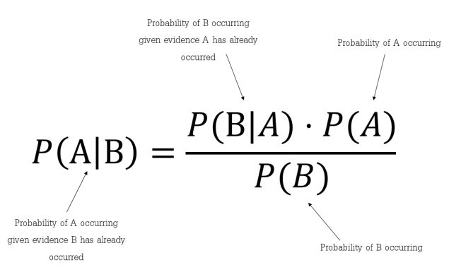
Building the Model
Naïve Bayes Classifier
labelCol = Indexed Polarity
featuresCol = TF-IDF Rescaled Data

Slide 12
Evaluating the Model
Multiclass Classification Evaluator
Generates predictions of the data
Tests accuracy of predictions to training set
94%
Model Accuracy

Slide 13
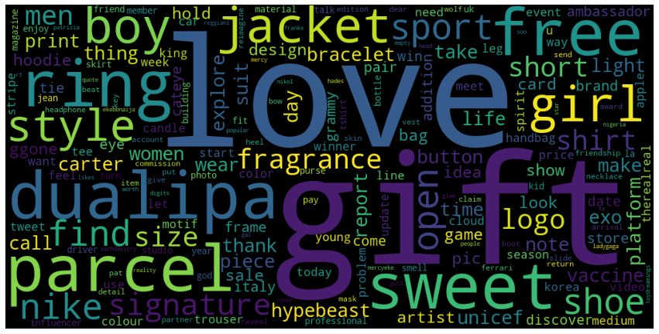
Findings & Results

Slide 14
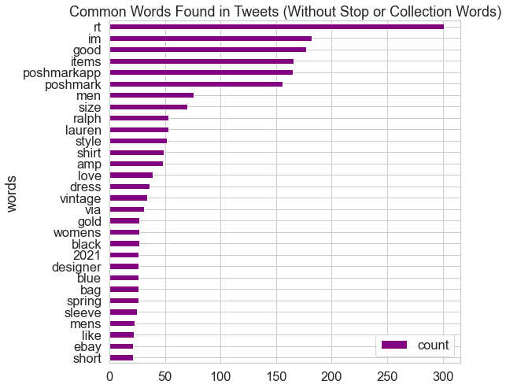
Findings & Results

Slide 15

Business Impacts
Identify fashion trends
Input on what direction large companies are heading
Insight into public opinion
Helps to guide decisions around marketing and product development for our firm

Slide 16
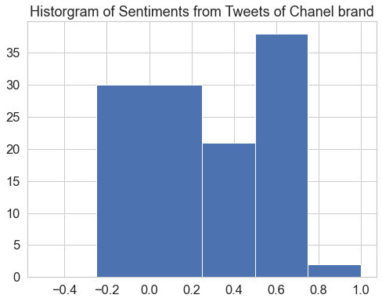
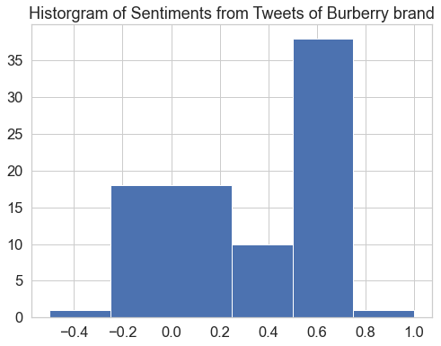
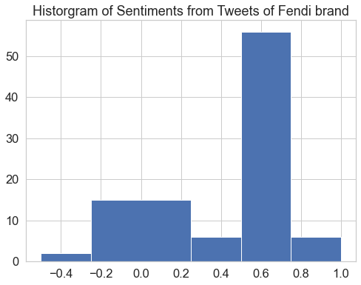
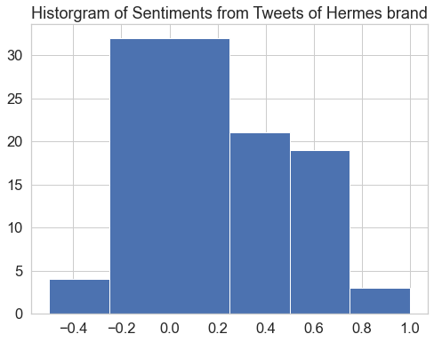
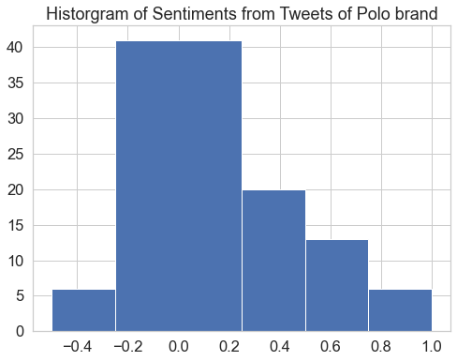
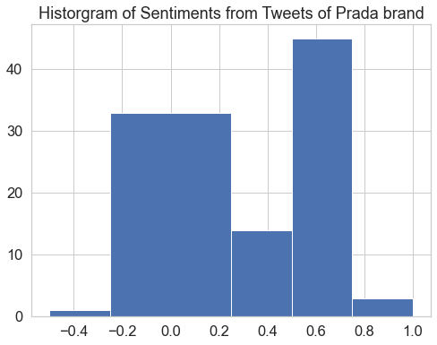
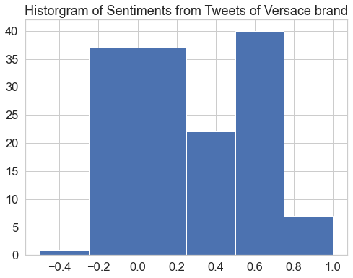
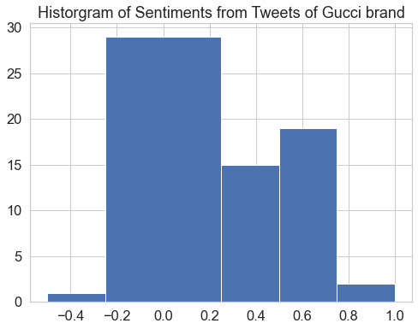
Company Analysis

Slide 17
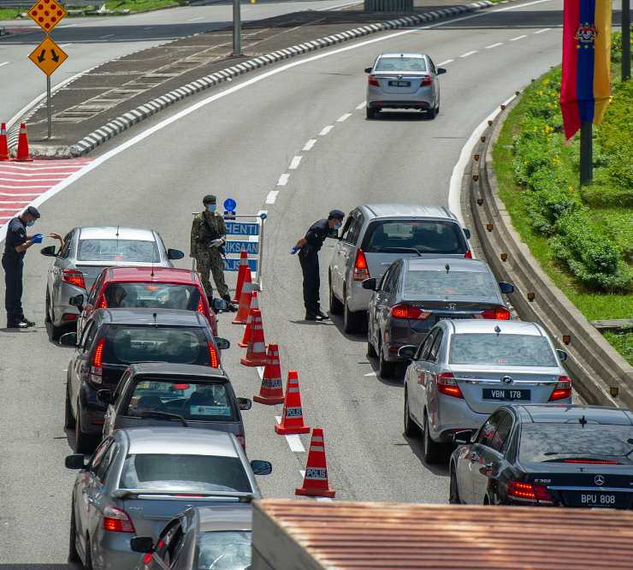
Next Steps
Expanding the testing set
Using benchmark testing data
Cross validation of results
Running outside data through the model

Slide 18
Thank you

